Slide 1

A Closer Look at Deaths due to Cerebrovascular Disease over a General Timeline
By Megha Ravi

Slide 2
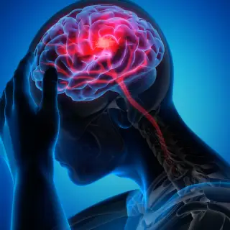
What is Cerebrovascular Disease?
Cerebrovascular diseases: “a range of conditions that affect the blood vessels (vascular system) in the brain and spinal cord1
examples: stroke, brain aneurysm, Carotid Artery Disease, Moyamoya Disease, etc1
5th leading cause of death in U.S.(2022)2
“stroke is a leading cause of serious long term disability”3
Risk of cerebrovascular disease can be reduced by following a healthy lifestyle4
stroke and brain aneurysm preventable risk factors: smoking, diabetes, obesity, high blood pressure, drug use, and alcohol use 5
Sources:
1. pennmedicine.org
2. cdc.gov
3. aans.org
4. my.clevelandclinic.org
5. mayoclinic.org
Notes:
Some due to older age, genetics, and being female https://www.mayoclinic.org/diseases-conditions/brain-aneurysm/symptoms-causes/syc-20361483

Slide 3
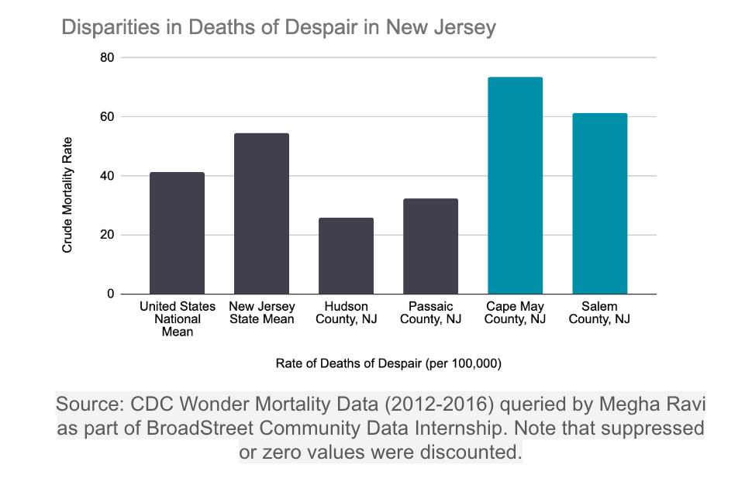
Why Salem County?
Most concerning county: Salem
Crude mortality rate: 61.4
Deaths: 198 deaths, about 121 deaths related to Cerebrovascular Disease
County with 2nd highest overall crude mortality rate
Cerebrovascular diseases may be more preventable in Salem than Cape May because Cape May is popular retirement area for older people
Sources:
https://wonder.cdc.gov/
www.countyhealthrankings.org
https://www.njspotlightnews.org
https://data.census.gov/

Slide 4
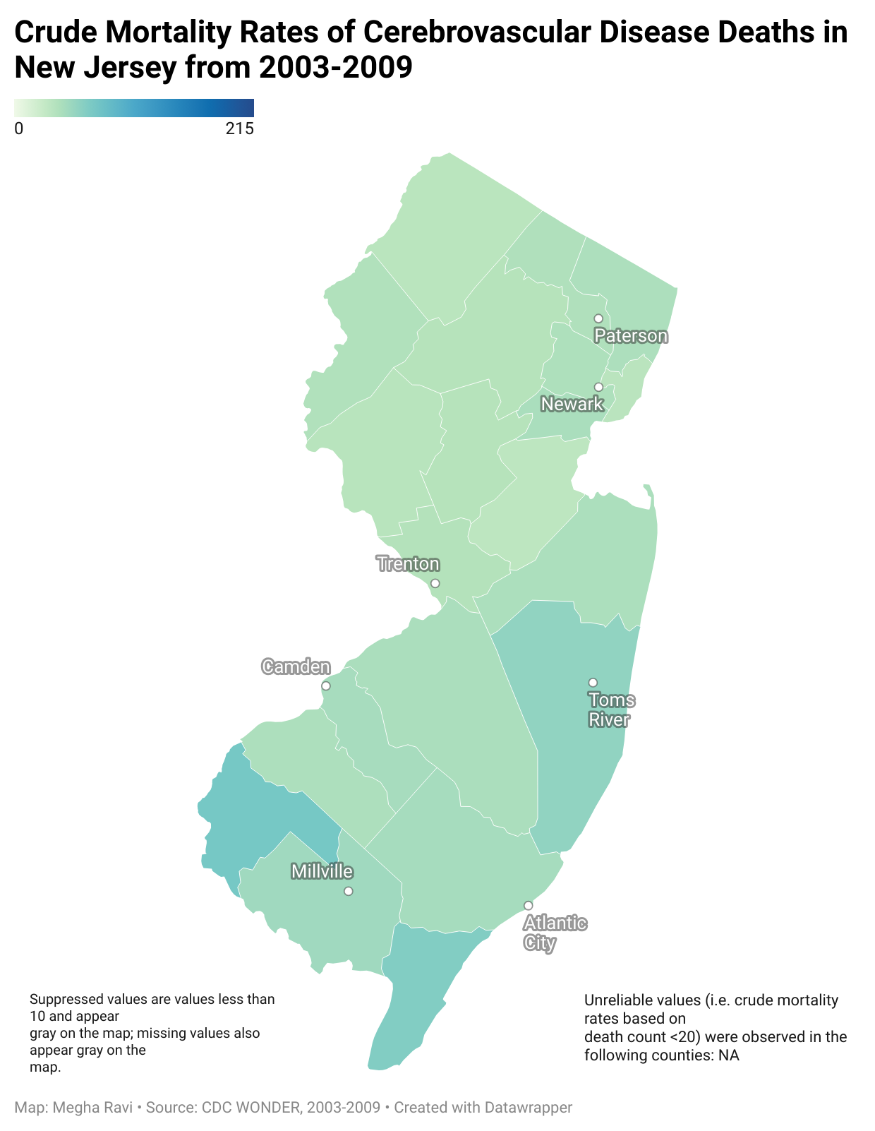
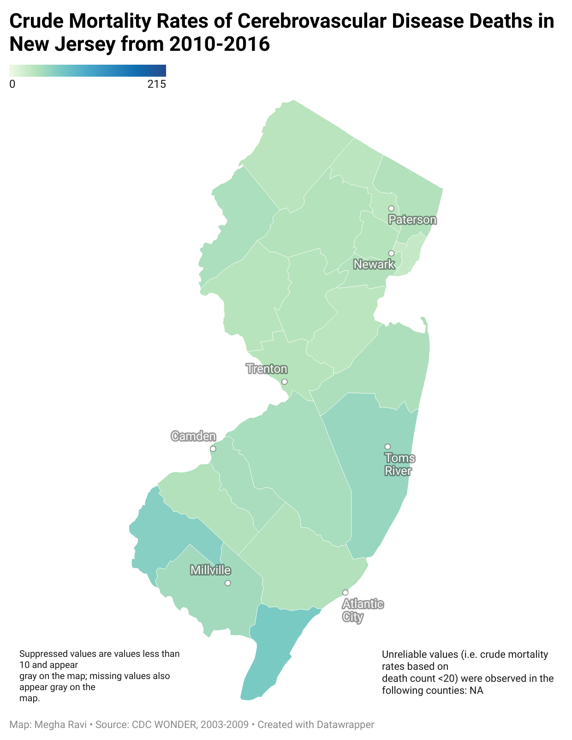
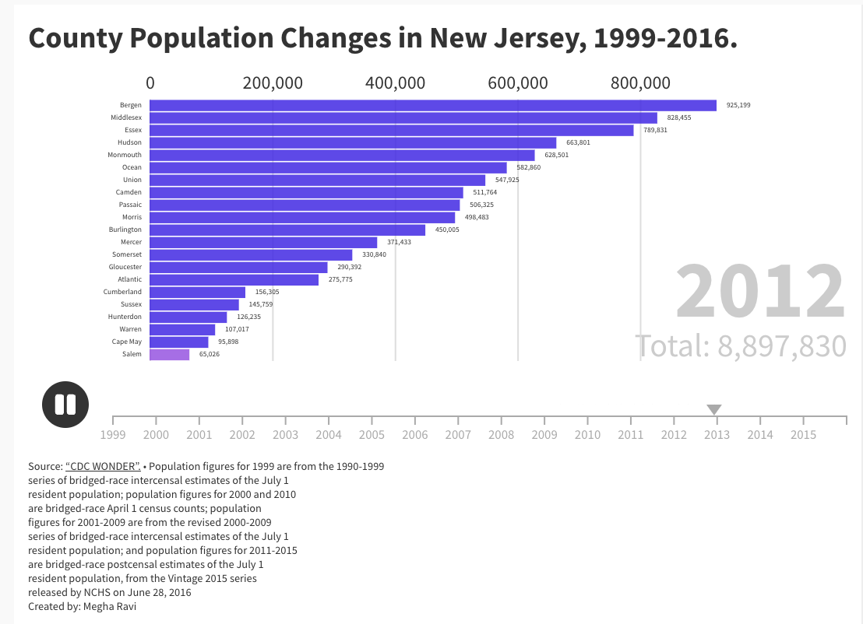
Over the Years
Salem County
Salem County
Notes:
Same ppl

Slide 5
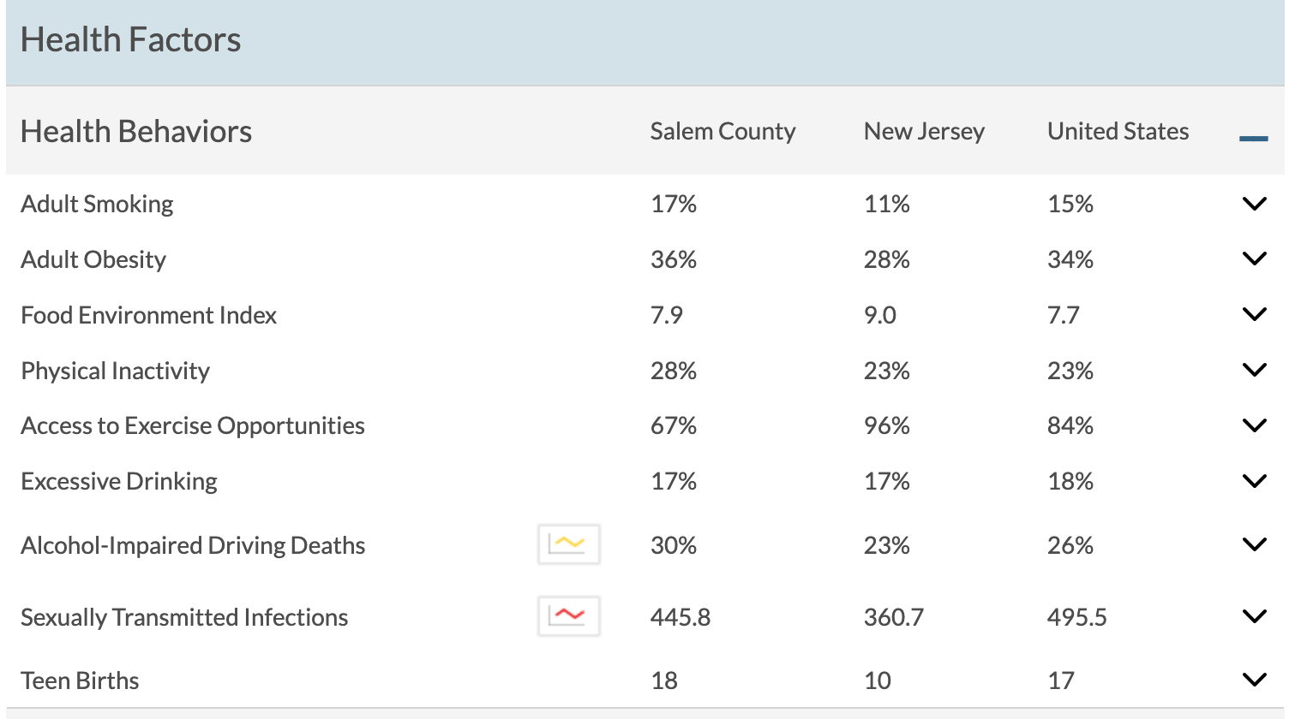
Important Demographics
Demographics, Health & Economic Factors
13.5% Non-Hispanic Black
50.7% Female
53.2% Rural
21.7% below 18 years of age
19.4% age 65 and older
71.7% Non-Hispanic White vs NJ 52.9%
53.2% Rural vs 6.2% NJ
Adult Obesity: 36% vs 28% NJ
Access to exercise opportunities: 67% vs 96% NJ
Median Income: $77,898 vs $96,346 NJ
Health factors:
Adult Smoking: 17% SC vs 11% NJ
Adult Obesity: 36% SC vs 28% NJ
Physical Inactivity: 28% SC vs 23% NJ
Access to Exercise Opportunities: 67% SC vs 96% NJ
Sources:
https://wonder.cdc.gov/
www.countyhealthrankings.org
https://www.njspotlightnews.org
https://data.census.gov/

Slide 6
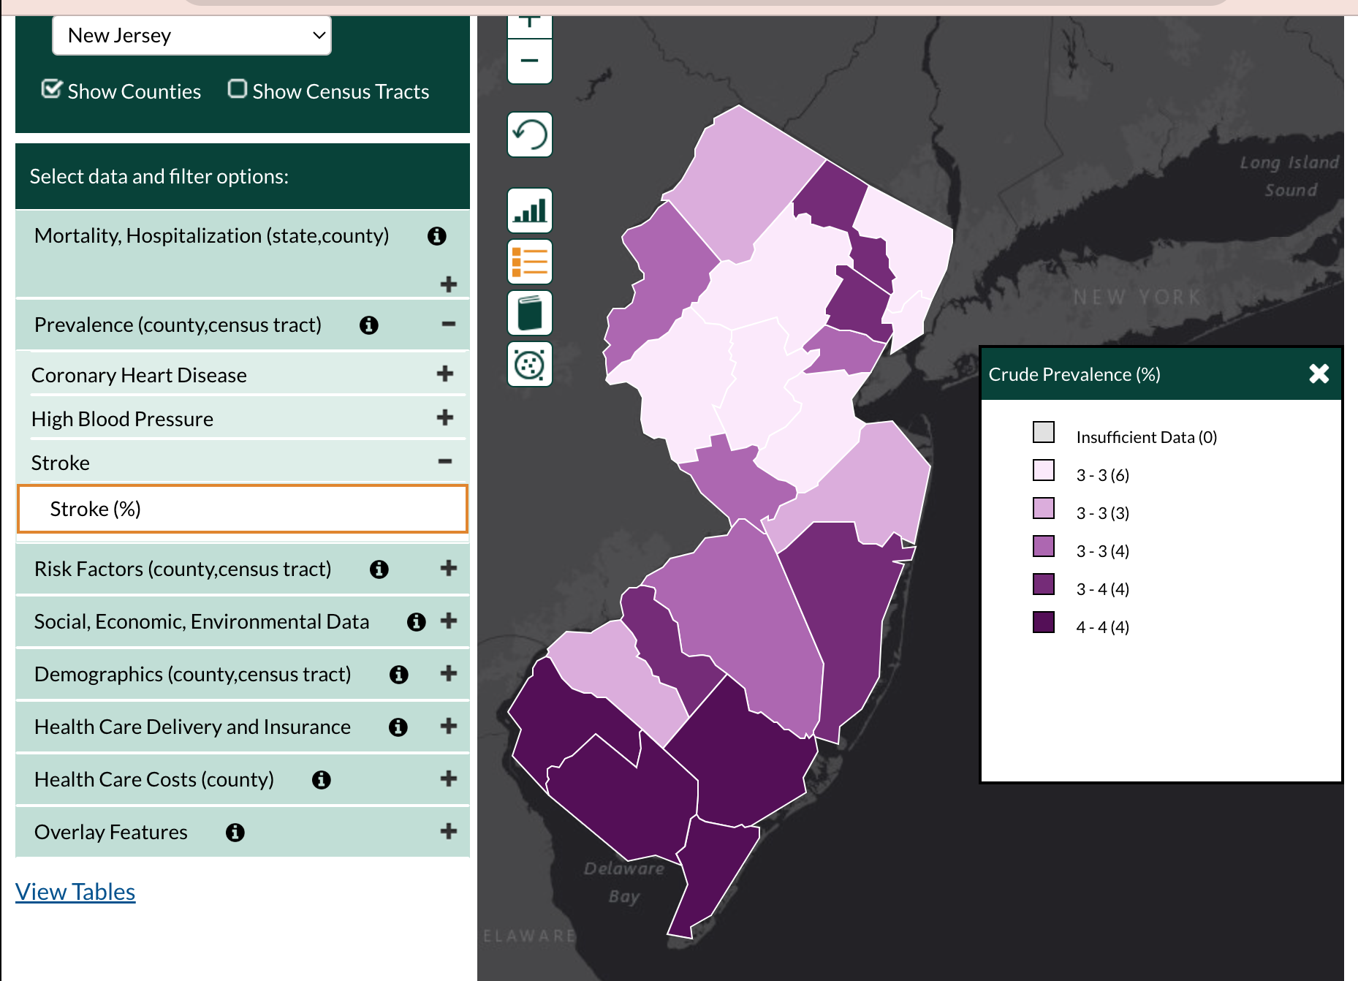
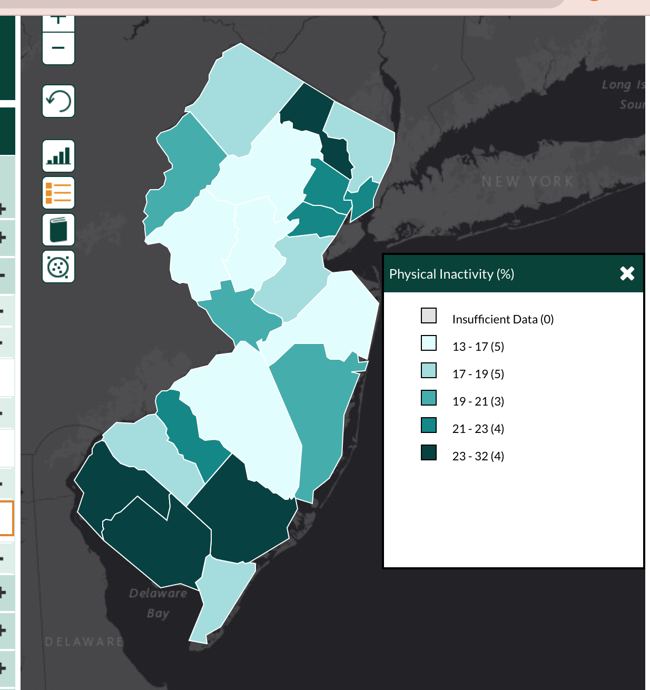
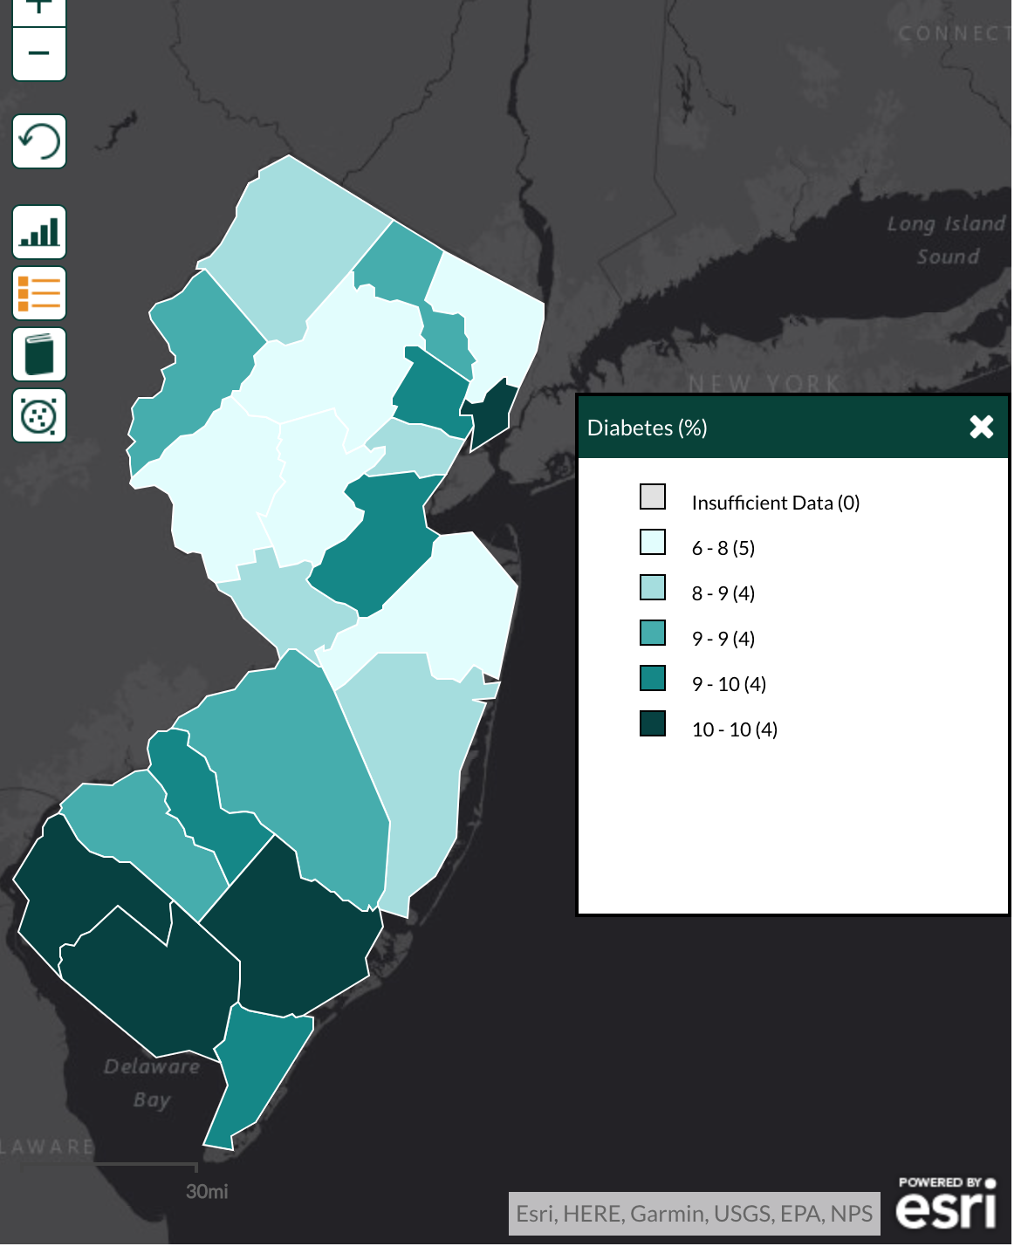
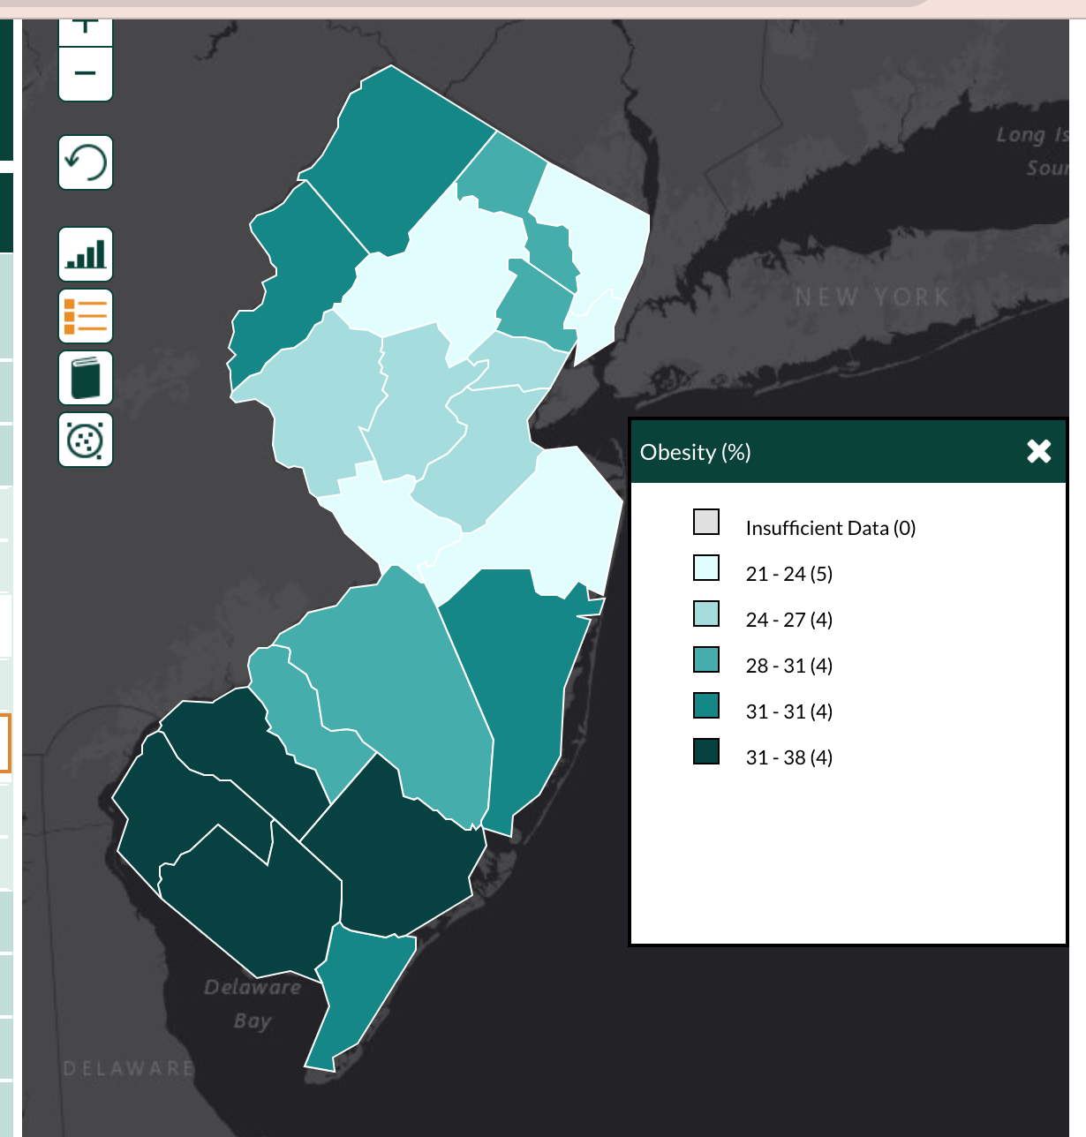
Prevalence and Risk Factors
Stroke Prevalence
Physical Inactivity
Diabetes
Obesity
Sources:
https://nccd.cdc.gov/
Notes:
Add that smoking was also prevalent

Slide 7
Moving Forward
Overall, would recommend more access to physical activity opportunities such as government/county programs by Salem County Department of Health & Human Services
Suggested evidence based interventions for improvement:
Increase muscle-strengthening activity programs (physical activity)
Self-management education programs (diabetes)
Counseling and education on weight reduction, physical activity, nutrition
Senator Cory Booker
Reducing Obesity in Youth Act
New Jersey Department of Health and Senior Services has Nutrition, Physical Activity, and Obesity Program
promotes healthy eating and physical activity
Sources:
health.gov
Notes:
Add that smoking was also prevalent

